Slide 1

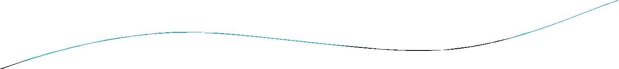


Shortest Paths

Slide 2



Weighted Graphs
Graphs that have a number assigned to each edge are called weighted graphs.
BOS
CHI
NY
SF
DEN
ATL
LA
MIA

Slide 3

Weighted Graphs
MILES
BOS
2534
1855
722
NY
CHI
SF
DEN 908
957
349
ATL
595
MIA
LA

Slide 4

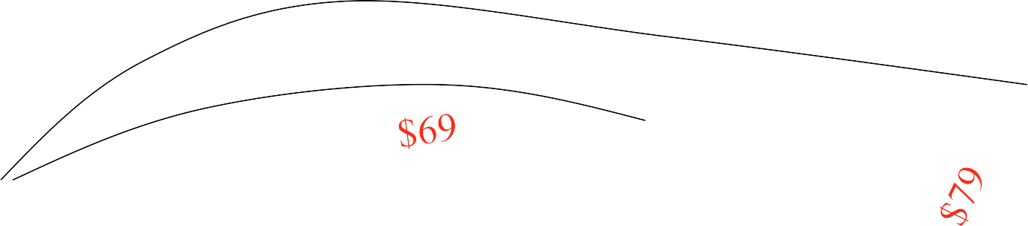
Weighted Graphs
FARES
BOS
$129
$39
NY
$99
$59
CHI
SF
DEN
$89
$39
ATL
LA
MIA

Slide 5

Weighted Graphs
FLIGHT TIMES
BOS
4:05
0:50
NY
2:55
CHI
1:50
SF
DEN 2:10
2:20
1:15
ATL
LA
MIA

Slide 6

Weighted Graphs
A weighted graph is a graph in which each edge (u, v) has a weight w(u, v). Each weight is a real number.
Weights can represent distance, cost, time, capacity, etc.
The length of a path in a weighted graph is the sum of the weights on the edges.
Dijkstra’s Algorithm finds the shortest path between two vertices.

Slide 7

Dijkstra’s Algorithm
Dijkstra’s algorithm is used in problems relating to finding the shortest path.
Each node is given a temporary label denoting the length of the shortest
path from the start node so far.
This label is replaced if another shorter route is found.
Once it is certain that no other shorter paths can be found, the temporary label becomes a permanent label.
Eventually all the nodes have permanent labels.
At this point the shortest path is found by retracing the path backwards.

Slide 8

Dijkstra’s algorithm: example
D(v) D(w) D(x) D(y) D(z)
Step N'
0 | u | 7,u | 3,u | 5,u | ∞ | ∞
1 | uw | 6,w |  | 5,u | 11,w | ∞
2 | uwx | 6,w |  |  | 11,w | 14,x
3 | uwxv |  |  |  | 10,v | 14,x
4 uwxvy
12,y
5
uwxvyz
x
9
notes:
construct shortest path tree by tracing predecessor nodes
ties can exist (can be broken arbitrarily)
5
7
4
8
u
3
w
y
z
2
3
7
4
v

Slide 9
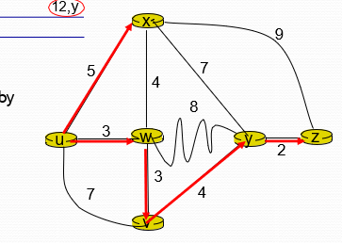
Here the starting point is u
Selected Vertex | X | W | V | Y | Z
U | 5 | 3 | 7 | ∞ | ∞

Slide 10
We select W because it has least distance from U.
Selected Vertex | X | W | V | Y | Z
U | 5 | 3 | 7 | ∞ | ∞
Y needs to be relaxed!!
Edge relaxation means assigning a less possible cost to destination

Slide 11
We select W because it has least distance from U.
Selected Vertex | X | W | V | Y | Z
U | 5 | 3 | 7 | ∞ | ∞
W |  |  |  | 11 | ∞

Slide 12
We select X because it has least distance from U.
Selected Vertex | X | W | V | Y | Z
U | 5 | 3 | 7 | ∞ | ∞
W | 5 | 3 | 6 | 11 | ∞

Slide 13
We select W because it has least distance from U.
Selected Vertex | X | W | V | Y | Z
U | 5 | 3 | 7 | ∞ | ∞
W | 5 | 3 | 6 | 11 | ∞
X | 5 | 3 | 6 | 11 | 14

Slide 14
We select V because it has least distance from U.
Selected Vertex | X | W | V | Y | Z
U | 5 | 3 | 7 | ∞ | ∞
W | 5 | 3 | 6 | 11 | ∞
X | 5 | 3 | 6 | 11 | 14

Slide 15
We select Y because it has least distance from U.
Selected Vertex | X | W | V | Y | Z
U | 5 | 3 | 7 | ∞ | ∞
W | 5 | 3 | 6 | 11 | ∞
X | 5 | 3 | 6 | 11 | 14
V | 5 | 3 | 6 | 10 | 14

Slide 16
We select W because it has least distance from U.
Selected Vertex | X | W | V | Y | Z
U | 5 | 3 | 7 | ∞ | ∞
W | 5 | 3 | 6 | 11 | ∞
X | 5 | 3 | 6 | 11 | 14
V | 5 | 3 | 6 | 10 | 14
Y | 5 | 3 | 6 | 10 | 12

Slide 17
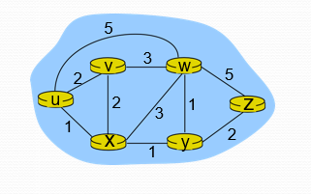

Slide 18

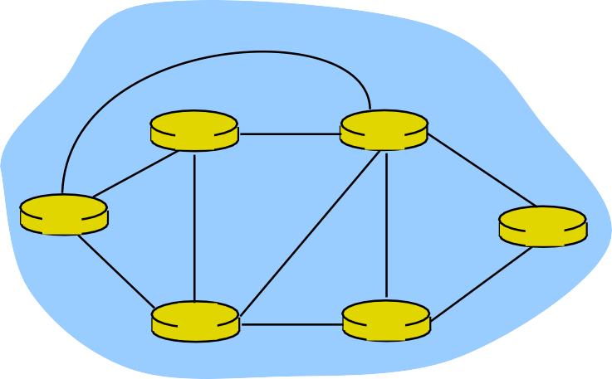
Dijkstra’s algorithm: another example
Step
0
N'
D(v)
D(w) D(x)
5,u 1,u
D(y)
∞
D(z)
∞
u
2,u
1
ux
2,u
4,x
2,x
∞
4,y
2
uxy
2,u
3,y
3,y
3
uxyv
4,y
4,y
4
5
uxyvw
uxyvwz
5
v
3
w
2
5
u
2
1
z
3
1
2
x
y
1

Slide 19

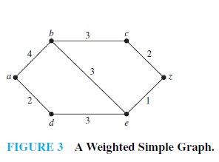

Slide 20

The Traveling Salesman Problem
The traveling salesman problem is one of the classical problems in computer science.
A traveling salesman wants to visit a number of cities and then return to his starting point. Of course he wants to save time and energy, so he wants to determine the shortest cycle for his trip.
We can represent the cities and the distances between them by a weighted, complete, undirected graph.
The problem then is to find the shortest cycle (of minimum total weight that visits each vertex exactly one).
Finding the shortest cycle is different than Dijkstra’s shortest path.
It is much harder too, no polynomial time algorithm exists!

Slide 21

The Traveling Salesman Problem
Importance:
Variety of scheduling application can be solved as a
traveling salesmen problem.
Examples:
Ordering drill position on a drill press.
School bus routing.
The problem has theoretical importance because it represents a class of difficult problems known as NP-hard problems.

Slide 22

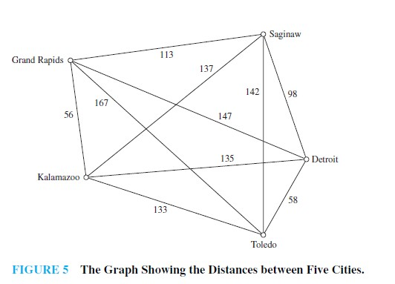
Travelling Salesman problem

Slide 23

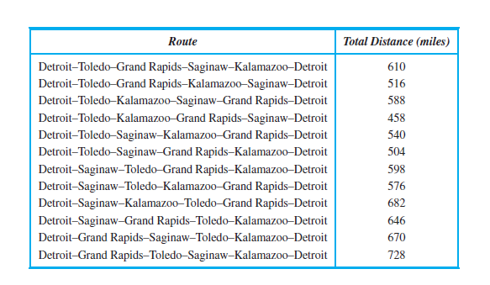
Travelling Salesman problem

Slide 24
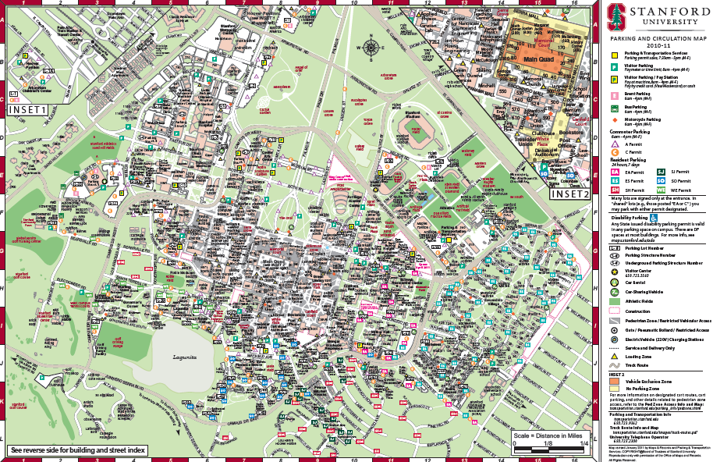
SHORTEST PATHS IN WEIGHTED GRAPHS
Suppose you only know your way around campus via certain landmarks
Caltrain
Stadium
Gates
Memchu
Chipotle
Wilbur Dining
Old Union
The Dish

Slide 25
SHORTEST PATHS IN WEIGHTED GRAPHS
We can represent this as a weighted graph where w(u,v) = weight of an edge (u, v).
For today, these weights are non-negative.
Caltrain
4
12
Stadium
3
15
Gates
Note: All graphs are directed, but to save the trouble of drawing double arrows everywhere:
=
2
Memchu
2
21
Chipotle
Wilbur Dining
Old Union
1
10
15
The Dish

Slide 26
SHORTEST PATHS IN WEIGHTED GRAPHS
We can represent this as a weighted graph where w(u,v) = weight of an edge (u, v).
For today, these weights are non-negative.
Caltrain
4
12
Stadium
3
15
What if we wanted to compute the shortest path from Gates to Old Union?
Gates
2
Memchu
2
21
Chipotle
Wilbur Dining
BFS would say via The Dish.
This is because BFS doesn’t take any edge weights into account!
Old Union
1
10
15
The Dish

Slide 27
SHORTEST PATHS IN WEIGHTED GRAPHS
The shortest path between v and w in a weighted graph is the path with the minimum cost.
Caltrain
4
12
Stadium
Cost of a path
=
sum of weights along that path
3
15
Gates
2
Memchu
2
21
Chipotle
Wilbur Dining
Old Union
1
10
15
The Dish

Slide 28
SHORTEST PATHS IN WEIGHTED GRAPHS
The shortest path between v and w in a weighted graph is the path with the minimum cost.
Caltrain
4
12
Stadium
Cost of a path
=
sum of weights along that path
3
15
Gates
2
Memchu
2
21
Chipotle
Wilbur Dining
Old Union
1
10
This path from Gates to Old Union has cost 36.
15
The Dish

Slide 29
SHORTEST PATHS IN WEIGHTED GRAPHS
The shortest path between v and w in a weighted graph is the path with the minimum cost.
Caltrain
4
12
Stadium
Cost of a path
=
sum of weights along that path
3
15
Gates
2
Memchu
2
21
Chipotle
Wilbur Dining
Old Union
1
10
15
This path from Gates to Old Union only has cost 5.
The Dish

Slide 30
SHORTEST PATHS IN WEIGHTED GRAPHS
The distance d(v,w) between 2 vertices v and w is the cost of the shortest path between v and w
Caltrain
4
12
Stadium
3
15
d(Gates, Old Union) = 5
Gates
2
Memchu
2
21
Chipotle
Wilbur Dining
Old Union
1
10
15
The Dish

Slide 31
SINGLE-SOURCE SHORTEST PATH
How long is the shortest path between vertex v and all other vertices w?
On Monday, we saw that we can use BFS & the BFS layers to pretty easily solve this task for unweighted graphs.
Dijkstra’s algorithm solves the single-source shortest path problem on weighted graphs with non-negative edge weights.
Applications:
Finding the shortest/most efficient path from point A to point B via bike, walking, Uber, Lyft, train, etc. (Edge weights could be time, money, hassle, effort)
Finding the shortest path to send packets from my computer to some desired server using the Internet
(Edge weights could be link length, traffic, etc.)

Slide 32
DIJKSTRA’S ALGORITHM: THE IDEA
Source node is s. For each node v, store an over-estimate of d(s, v).
These over-estimates start off as ∞, and we’ll iteratively work to make these over-estimates tighter and tighter, until they reach the true distance.
For demonstration purposes, we’ll use three colors again to keep track of the state of each node:
unsure node
current node
sure node

Slide 33
DIJKSTRA BY EXAMPLE
Suppose our single source node is Gates.
Caltrain
unsure node
12
4
Gates
Stadium
current node
3
2
15
sure node
Memchu
2
21
Wilbur Dining
Chipotle
10
1
The Dish
Old Union
15

Slide 34
DIJKSTRA BY EXAMPLE
∞
∞
Caltrain
unsure node
12
4
∞
∞
Gates
Stadium
∞
current node
3
2
15
sure node
Memchu
∞
∞
∞
2
Wilbur Dining
∞
21
Chipotle
∞
10
∞
1
We initialize all our overestimates:
d[v] = ∞
for all vertices v.
∞
∞
Old Union
The Dish
∞
15
∞

Slide 35
DIJKSTRA BY EXAMPLE
∞
∞
Caltrain
unsure node
12
4
∞
0
Gates
Stadium
∞
current node
3
2
15
sure node
Memchu
∞
∞
∞
2
Wilbur Dining
∞
21
Chipotle
∞
10
∞
1
∞
∞
Old Union
Since Gates is our source, first set
d[Gates] = 0
The Dish
∞
15
∞

Slide 36
DIJKSTRA BY EXAMPLE
∞
∞
Caltrain
unsure node
12
4
∞
0
Gates
Stadium
∞
current node
3
2
15
sure node
Memchu
∞
∞
∞
2
Wilbur Dining
∞
21
Chipotle
∞
10
∞
1
∞
∞
Old Union
Now pick the node with the smallest d[v]. That’s obviously Gates.
Call this node u.
The Dish
∞
15
∞

Slide 37
DIJKSTRA BY EXAMPLE
∞
Caltrain
unsure node
12
4
0
Gates
Stadium
∞
current node
3
2
15
sure node
Memchu
2
∞
∞
21
Wilbur Dining
Chipotle
∞
10
1
∞
Old Union
Update each of u’s neighbors v as follows:
d[v] = min(d[v], d[u] + w(u, v))
The Dish
15
∞

Slide 38
DIJKSTRA BY EXAMPLE
12
Caltrain
unsure node
12
4
0
Gates
Stadium
3
current node
3
2
15
sure node
Memchu
2
∞
∞
21
Wilbur Dining
Chipotle
2
10
1
21
Old Union
Update each of u’s neighbors v as follows:
d[v] = min(d[v], d[u] + w(u, v))
The Dish
15
∞

Slide 39
DIJKSTRA BY EXAMPLE
12
Caltrain
unsure node
12
4
0
Gates
Stadium
3
current node
3
2
15
sure node
Memchu
2
∞
∞
21
Wilbur Dining
Chipotle
2
10
1
21
Old Union
Mark current node u as sure.
The Dish
15
∞

Slide 40
DIJKSTRA BY EXAMPLE
12
Caltrain
unsure node
12
4
0
Gates
Stadium
3
current node
3
2
15
sure node
Memchu
2
∞
∞
21
Wilbur Dining
Chipotle
2
10
1
21
Old Union
Now pick the next node with the smallest d[v]. That’s MemChu.
(we’ll call this node u now).
The Dish
15
∞

Slide 41
DIJKSTRA BY EXAMPLE
12
Caltrain
unsure node
12
4
0
Gates
Stadium
3
current node
3
2
15
sure node
Memchu
2
∞
∞
21
Wilbur Dining
Chipotle
2
10
1
21
Old Union
Update each of u’s unsure neighbors v as follows:
d[v] = min(d[v], d[u] + w(u, v))
The Dish
15
∞

Slide 42
DIJKSTRA BY EXAMPLE
12
Caltrain
unsure node
12
4
0
Gates
Stadium
3
current node
3
2
15
sure node
Memchu
2
4
∞
21
Wilbur Dining
Chipotle
2
10
1
21
Old Union
Update each of u’s unsure neighbors v as follows:
d[v] = min(d[v], d[u] + w(u, v))
The Dish
15
∞

Slide 43
DIJKSTRA BY EXAMPLE
12
Caltrain
unsure node
12
4
0
Gates
Stadium
3
current node
3
2
15
sure node
Memchu
2
4
∞
21
Wilbur Dining
Chipotle
2
10
1
21
Old Union
Mark current node u as sure.
The Dish
15
∞

Slide 44
DIJKSTRA BY EXAMPLE
12
Caltrain
unsure node
12
4
0
Gates
Stadium
3
current node
3
2
15
sure node
Memchu
2
4
∞
21
Wilbur Dining
Chipotle
2
10
1
21
Old Union
Now pick the next node with the smallest d[v]. That’s Stadium.
(we’ll call this node u now).
The Dish
15
∞

Slide 45
DIJKSTRA BY EXAMPLE
12
Caltrain
unsure node
12
4
0
Gates
Stadium
3
current node
3
2
15
sure node
Memchu
2
4
∞
21
Wilbur Dining
Chipotle
2
10
1
21
Old Union
Update each of u’s unsure neighbors v as follows:
d[v] = min(d[v], d[u] + w(u, v))
The Dish
15
∞

Slide 46
DIJKSTRA BY EXAMPLE
7
Caltrain
unsure node
12
4
0
Gates
Stadium
3
current node
3
2
15
sure node
Memchu
2
4
18
21
Wilbur Dining
Chipotle
2
10
1
21
Old Union
Update each of u’s unsure neighbors v as follows:
d[v] = min(d[v], d[u] + w(u, v))
The Dish
15
∞

Slide 47
DIJKSTRA BY EXAMPLE
7
Caltrain
unsure node
12
4
0
Gates
Stadium
3
current node
3
2
15
sure node
Memchu
2
4
18
21
Wilbur Dining
Chipotle
2
10
1
21
Old Union
Mark current node u as sure.
The Dish
15
∞

Slide 48
DIJKSTRA BY EXAMPLE
7
Caltrain
unsure node
12
4
0
Gates
Stadium
3
current node
3
2
15
sure node
Memchu
2
4
18
21
Wilbur Dining
Chipotle
2
10
1
21
Old Union
Now pick the next node with the smallest d[v]. That’s Wilbur Dining.
(we’ll call this node u now).
The Dish
15
∞

Slide 49
DIJKSTRA BY EXAMPLE
7
Caltrain
unsure node
12
4
0
Gates
Stadium
3
current node
3
2
15
sure node
Memchu
2
4
18
21
Wilbur Dining
Chipotle
2
10
1
21
Old Union
Update each of u’s unsure neighbors v as follows:
d[v] = min(d[v], d[u] + w(u, v))
The Dish
15
∞

Slide 50
DIJKSTRA BY EXAMPLE
7
Caltrain
unsure node
12
4
0
Gates
Stadium
3
current node
3
2
15
sure node
Memchu
2
4
14
21
Wilbur Dining
Chipotle
2
10
1
21
Old Union
Update each of u’s unsure neighbors v as follows:
d[v] = min(d[v], d[u] + w(u, v))
The Dish
15
5

Slide 51
DIJKSTRA BY EXAMPLE
7
Caltrain
unsure node
12
4
0
Gates
Stadium
3
current node
3
2
15
sure node
Memchu
2
4
14
21
Wilbur Dining
Chipotle
2
10
1
21
Old Union
Mark current node u as sure.
The Dish
15
5

Slide 52
DIJKSTRA BY EXAMPLE
7
Caltrain
unsure node
12
4
0
Gates
Stadium
3
current node
3
2
15
sure node
Memchu
2
4
14
21
Wilbur Dining
Chipotle
2
10
1
21
Old Union
Now pick the next node with the smallest d[v]. That’s Old Union.
(we’ll call this node u now).
The Dish
15
5

Slide 53
DIJKSTRA BY EXAMPLE
7
Caltrain
unsure node
12
4
0
Gates
Stadium
3
current node
3
2
15
sure node
Memchu
2
4
14
21
Wilbur Dining
Chipotle
2
10
1
21
Old Union
Update each of u’s unsure neighbors v as follows:
d[v] = min(d[v], d[u] + w(u, v))
The Dish
15
5

Slide 54
DIJKSTRA BY EXAMPLE
7
Caltrain
unsure node
12
4
0
Gates
Stadium
3
current node
3
2
15
sure node
Memchu
2
4
14
21
Wilbur Dining
Chipotle
2
10
1
20
Old Union
Update each of u’s unsure neighbors v as follows:
d[v] = min(d[v], d[u] + w(u, v))
The Dish
15
5

Slide 55
DIJKSTRA BY EXAMPLE
7
Caltrain
unsure node
12
4
0
Gates
Stadium
3
current node
3
2
15
sure node
Memchu
2
4
14
21
Wilbur Dining
Chipotle
2
10
1
20
Old Union
Mark current node u as sure.
The Dish
15
5

Slide 56
DIJKSTRA BY EXAMPLE
7
Caltrain
unsure node
12
4
0
Gates
Stadium
3
current node
3
2
15
sure node
Memchu
2
4
14
21
Wilbur Dining
Chipotle
2
10
1
20
Old Union
Now pick the next node with the smallest d[v]. That’s Caltrain.
(we’ll call this node u now).
The Dish
15
5

Slide 57
DIJKSTRA BY EXAMPLE
7
Caltrain
unsure node
12
4
0
Gates
Stadium
3
current node
3
2
15
sure node
Memchu
2
4
14
21
Wilbur Dining
Chipotle
2
10
1
20
Old Union
We’d update each of u’s unsure neighbors v,
but looks like u doesn’t have any unsure neighbors.
Just mark u as sure.
The Dish
15
5

Slide 58
DIJKSTRA BY EXAMPLE
7
Caltrain
unsure node
12
4
0
Gates
Stadium
3
current node
3
2
15
sure node
Memchu
2
4
14
21
Wilbur Dining
Chipotle
2
10
1
20
Old Union
Now pick the next node with the smallest d[v]. That’s Chipotle.
(we’ll call this node u now).
The Dish
15
5

Slide 59
DIJKSTRA BY EXAMPLE
7
Caltrain
unsure node
12
4
0
Gates
Stadium
3
current node
3
2
15
sure node
Memchu
2
4
14
21
Wilbur Dining
Chipotle
2
10
1
20
Old Union
We’d update each of u’s unsure neighbors v,
but looks like u doesn’t have any unsure neighbors.
Just mark u as sure.
The Dish
15
5

Slide 60
DIJKSTRA BY EXAMPLE
7
Caltrain
unsure node
12
4
0
Gates
Stadium
3
current node
3
2
15
sure node
Memchu
2
4
14
21
Wilbur Dining
Chipotle
2
10
1
20
Old Union
Now pick the next node with the smallest d[v]. That’s The Dish.
(we’ll call this node u now).
The Dish
15
5

Slide 61
DIJKSTRA BY EXAMPLE
7
Caltrain
unsure node
12
4
0
Gates
Stadium
3
current node
3
2
15
sure node
Memchu
2
4
14
21
Wilbur Dining
Chipotle
2
10
1
20
Old Union
We’d update each of u’s unsure neighbors v,
but looks like u doesn’t have any unsure neighbors.
Just mark u as sure.
The Dish
15
5

Slide 62
DIJKSTRA BY EXAMPLE
7
Caltrain
unsure node
12
4
0
Gates
Stadium
3
current node
3
2
15
sure node
Memchu
2
4
14
21
Wilbur Dining
Chipotle
2
10
1
20
Old Union
There are no more unsure nodes!
We’re done, and all d[v] = d(s,v)!
(Check for yourself)
The Dish
15
5

